Slide 1
Final Project Presentation
yiru(Chloe) lin

Slide 2
Project Aim
Exploring RPI 4 GPIOs, and software and hardware interactions.
Through an interactive arcade shooter game using Raspberry Pi with physical GPIO controls. Combining both electronic circuit design for physical controls.

Slide 3
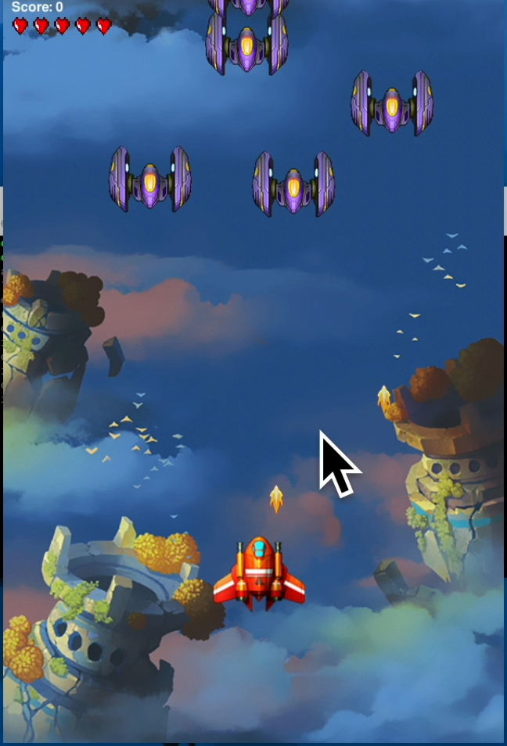
Project Introduction
Inspiration:
Galaxian arcade game: starfighter shoots down aliens to protect the earth.
This project:
Starfighter (Hero) shoots down Aliens (enemies).
Control left/right Hero movement.
Control bullet shooting.
Can pause/exit the game.
Each enemy worth 10 points.
If enemy hit hero or land on earth: hero lose 1 health.
Game ends when: long pressing exit button or Hero lose all health.

Slide 4
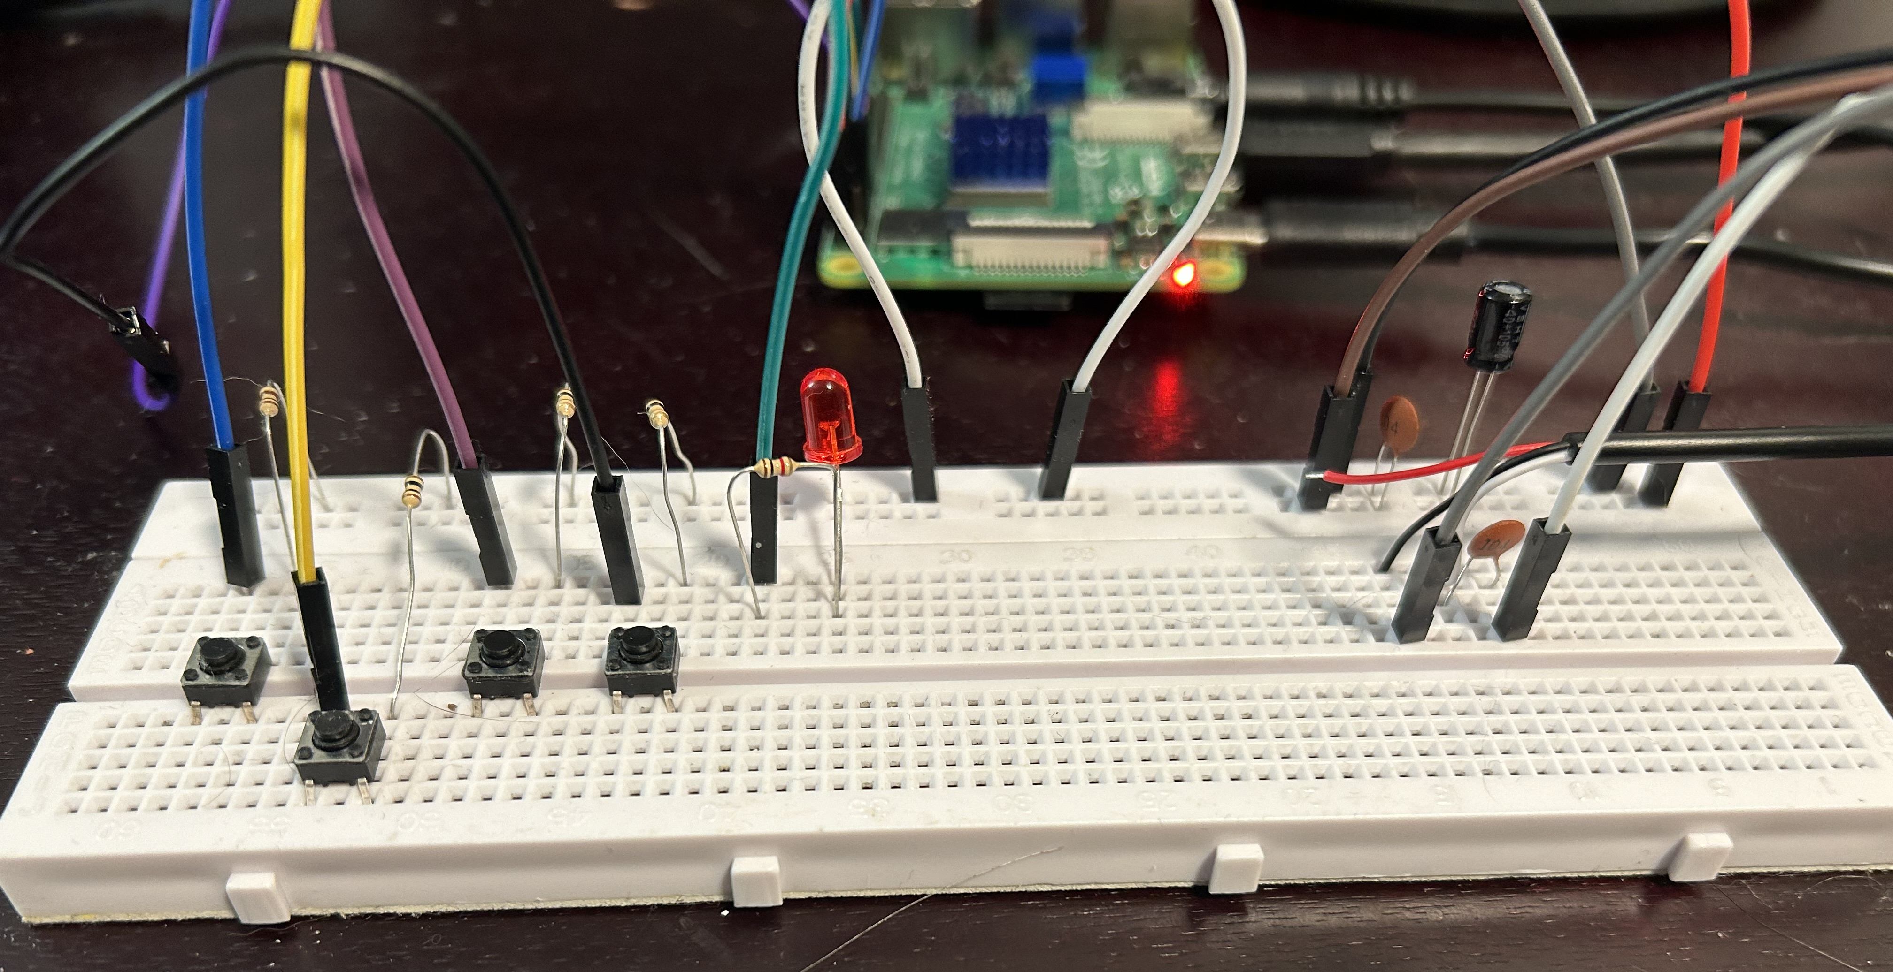
Project Design Overview (SW/HW)
Key software & hardware controls:
- Plane_main.py: the game logic and Hardware control.
- Game overall properties (flow, state, timer), Collisions detection, Hero’s Health, Game Score management.
- Hardware control: bullet, pause/resume and exit game. LED.
- Plane_sprites.py: all the sprite classes
- enemy, hero, health, bullet, background objects.
- Object: image, size, movement, explosion.
class PlaneGame(object):
def __init__(self):
self.left_button = Button(2) # GPIO2
self.left_button.when_pressed = self.move_left
# GPIO Button Functions
def move_left(self):
print("GPIO button was pressed: Let hero moves left")
self.hero.speed = -3

Slide 5
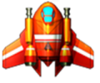
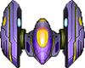
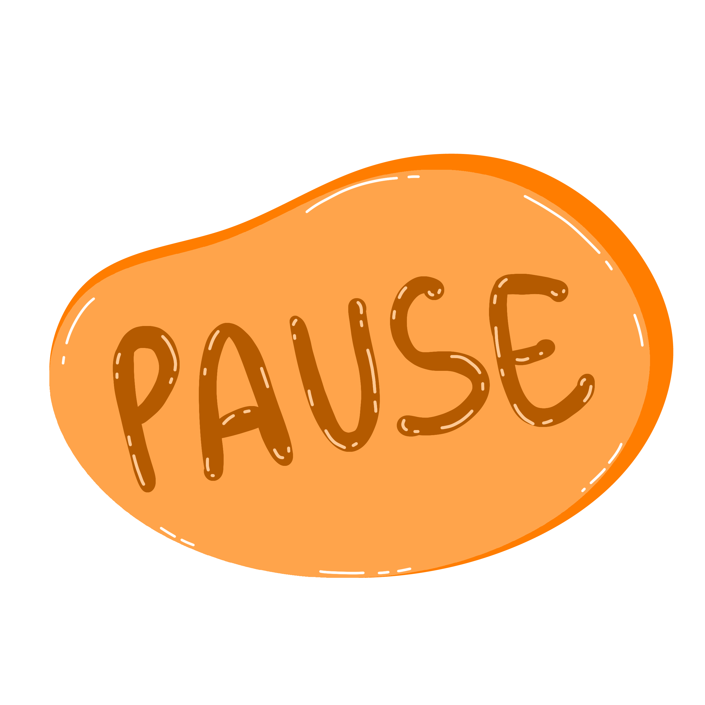
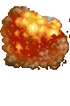

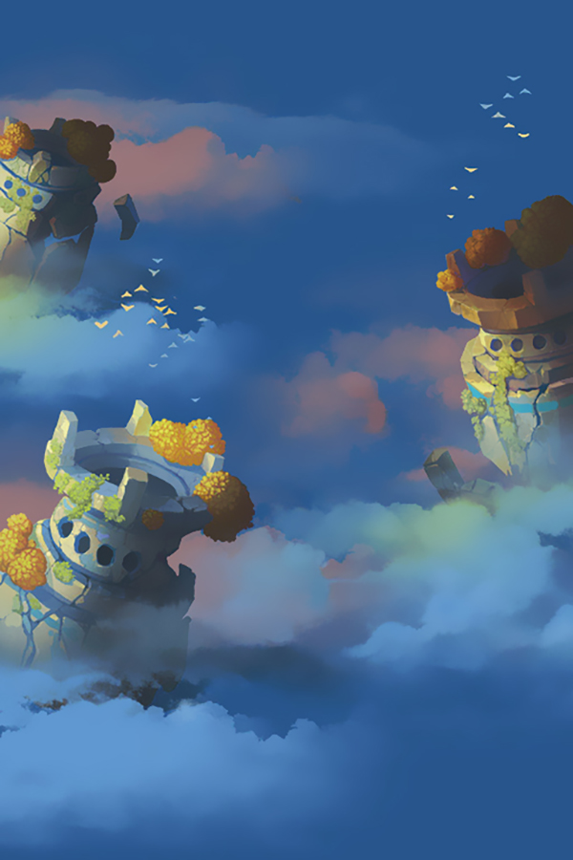
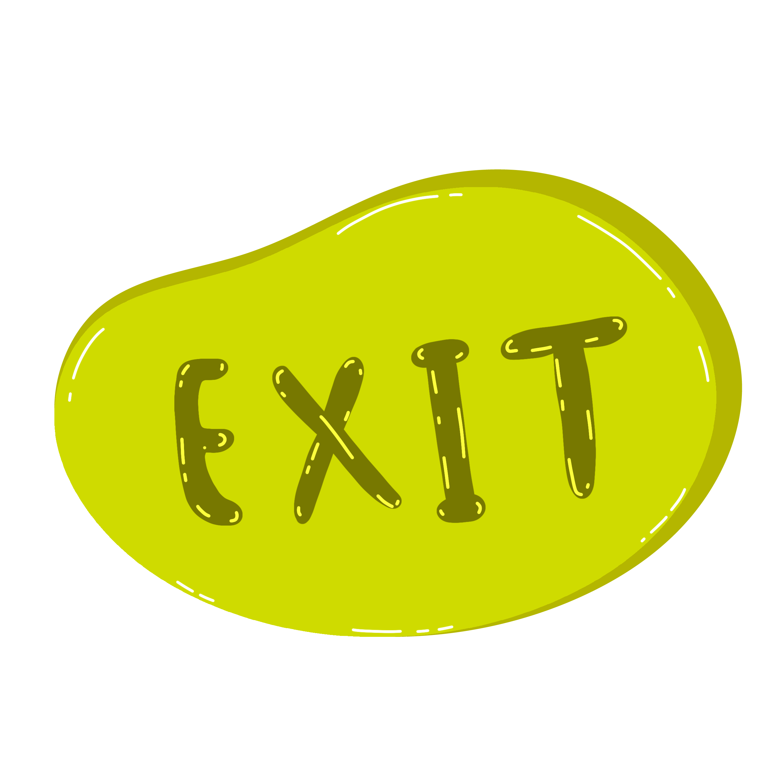
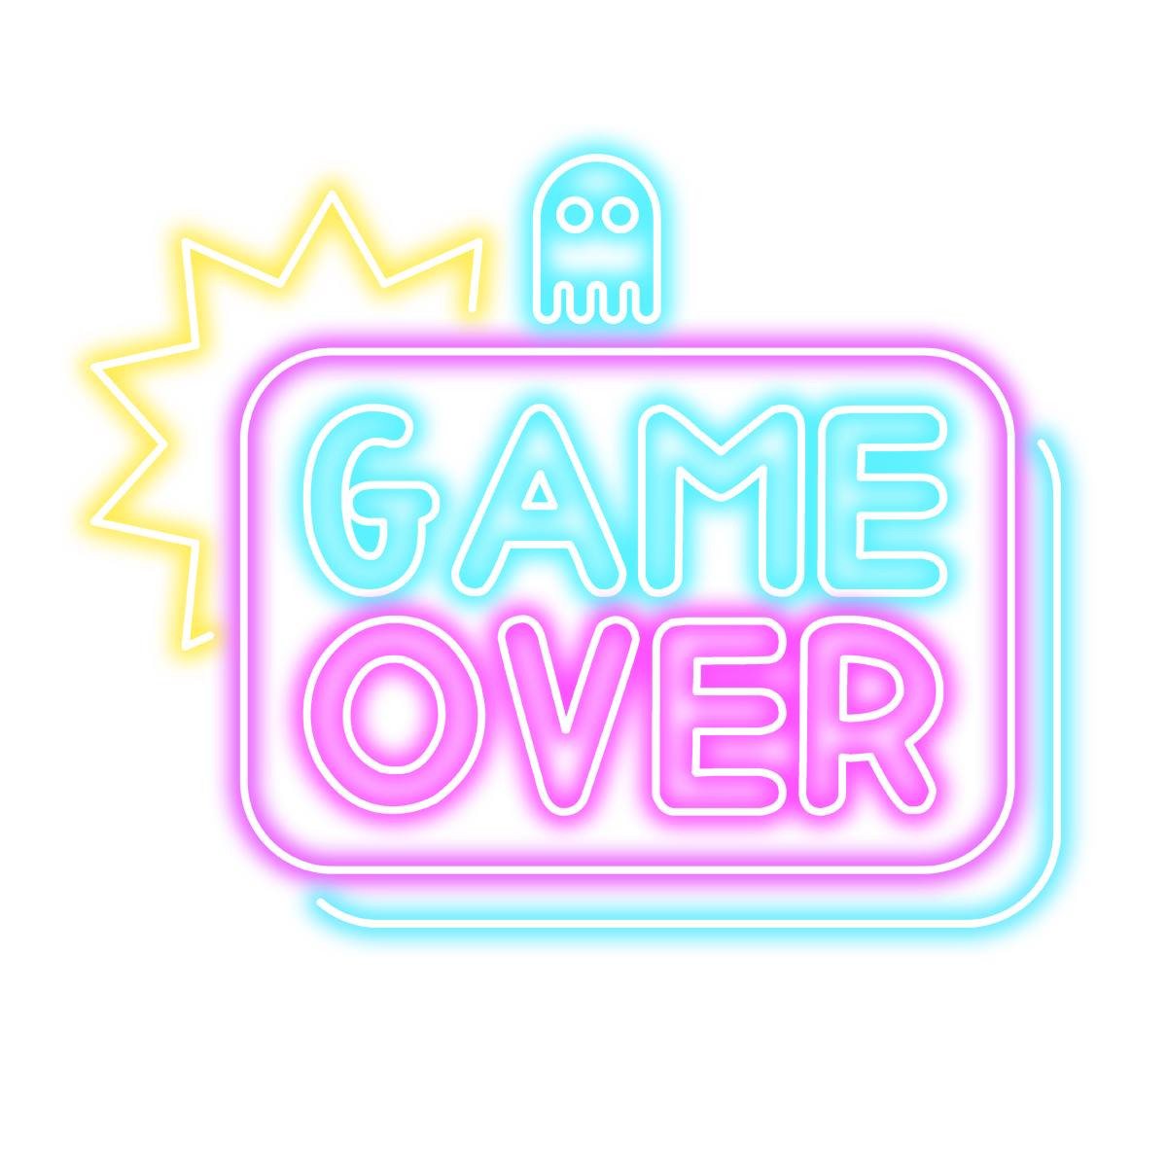
Software Design – Gather Resource
- First, Gather sources:
- Pictures: Hero planes Enemy planes: Bullet:
Explosion: Hero health: Pause game:
Exit game: Game Over. Background:
- Sound: Background track, Shooting bullet, Enemy plane explosion.

Slide 6
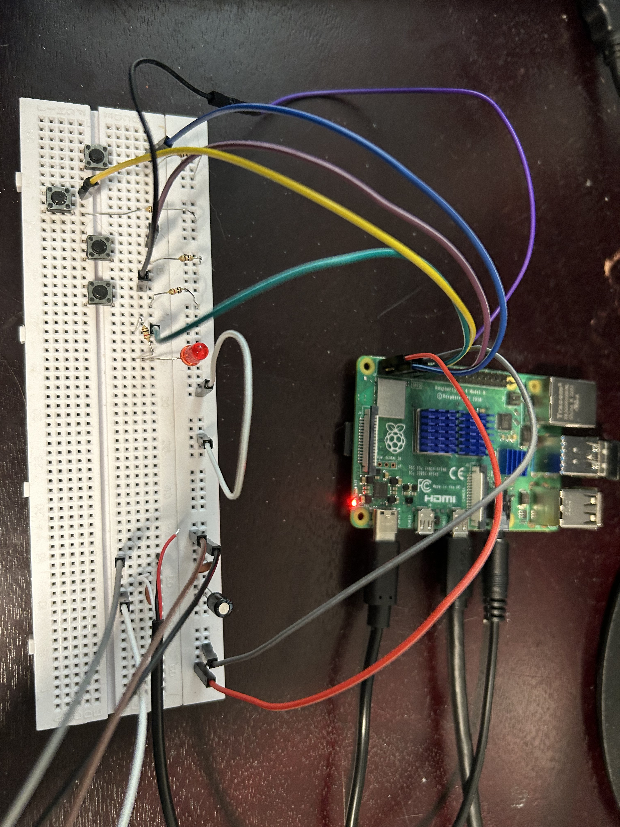
Software Design – Plane_main.py:
- Game Flow Management:
- Game initialization and main loop (60 FPS)
- State transitions (running, paused, game over, exit)
- Event handling for both Pygame and GPIO
- Sound System:
- Background music loop
- Shoot, Explosion sound
- Timer System:
- Enemy creation timer (every 1 second)
- Hardware control:
- Configures GPIO buttons (2, 3, 17, 27) for game controls
- Implements callback functions for button events
- Controls the status LED on GPIO 4
LED game indicator
Pause /Resume/ Exit
Left
Right
Shoot bullet

Slide 7
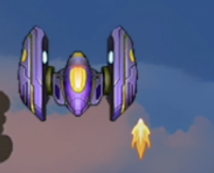
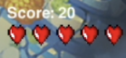
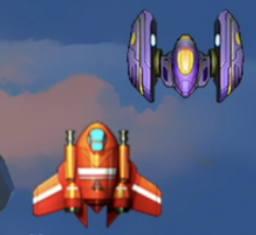
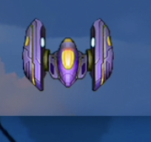
Software Design – Plane_main.py
- Hero's Health:
- Maintains 5 initial health points
- Removes heart sprites when health is lost
- Triggers game over when health reaches zero
- Score management:
- Awards 10 points for each destroyed enemy
- Renders score display at the top of the screen
Collision Detection:
- Bullet-to-Enemy collisions (score points)
- Enemy-to-Hero collisions (lose health)
- Enemy escaping bottom of screen (lose health)
Bullet-to-Enemy collision
Enemy-to-Hero collision
Enemy-Screen collision

Slide 8
Software Design – Plane_sprite.py
- Hero Class: Controlled by player input
- Horizontal movement within screen boundaries
- Bullet firing capability
- Bullet sprite group management
- Enemy Class: Random speed (1-3 pixels per frame)
- Random horizontal starting position
- Vertical downward movement
- Explosion creation on destruction
- Bullet Class: Upward vertical movement (-2 pixels per frame)
- Auto-destruction when leaving screen
- Collision detection with enemies

Slide 9
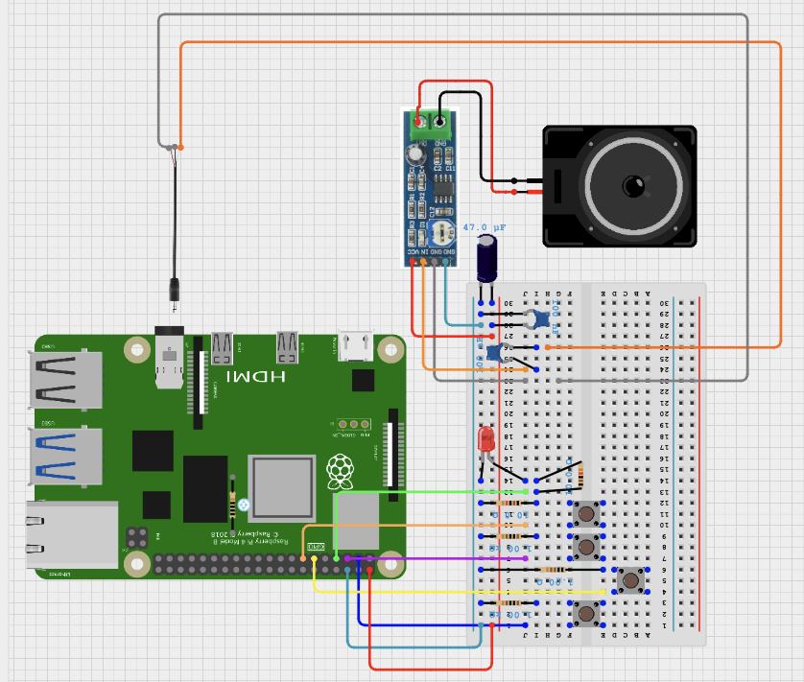
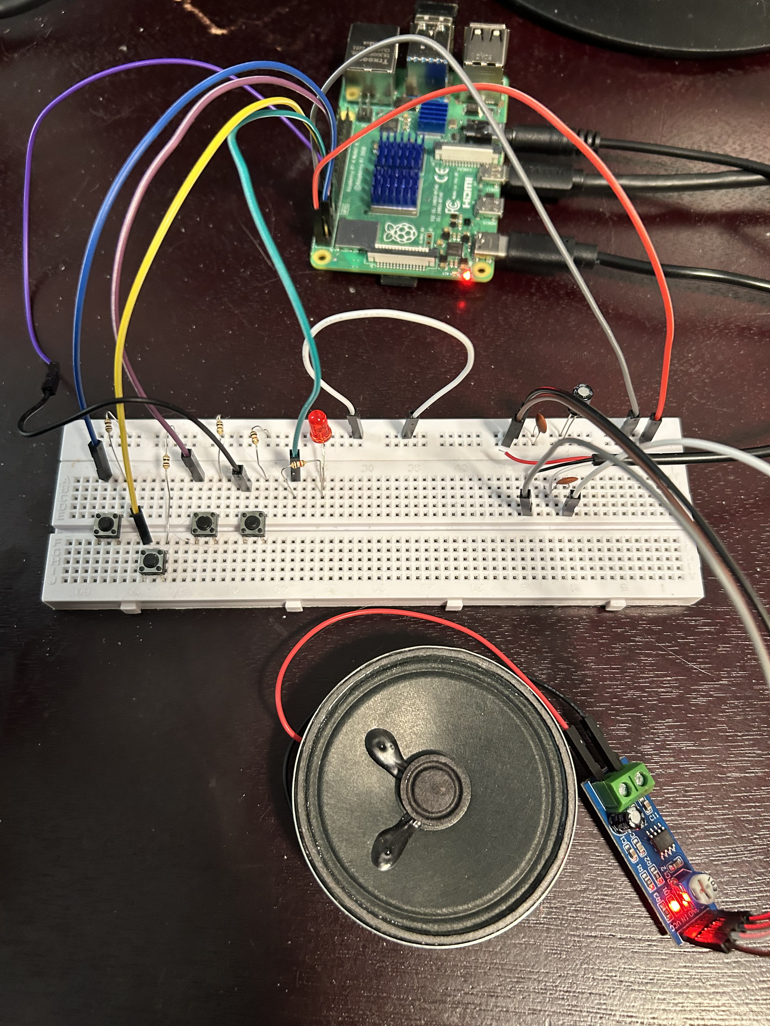
Hardware Design Diagram
Notes:
Speaker, Raspberry Pi 4, LM386 module, Breadboard.

Slide 10
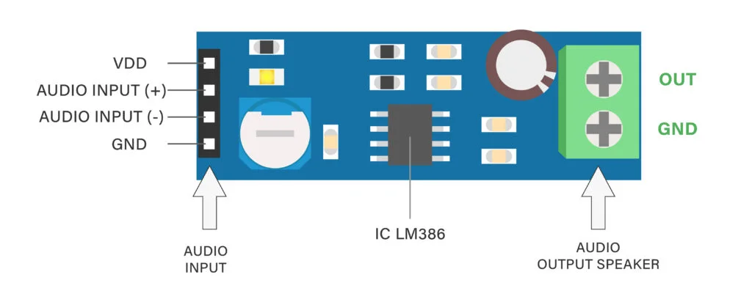
Hardware components
1 x Raspberry Pi 4
1 x Speaker: 8 ohms.
1 x Breadboard
Resistors ( 10k, 1k, ) Capacitors (47 uF, 0.1 uF )
1 x Audio Jack to wires ( GND, Left, Right channels)
Several Jumper wires: F/F, F/M, M/M
4 x Buttons ( left/right/bullets, pause/exit game)
1 x LED
1 x LM386 module
Notes:
Speaker, Raspberry Pi 4, LM386 module, Breadboard.

Slide 11
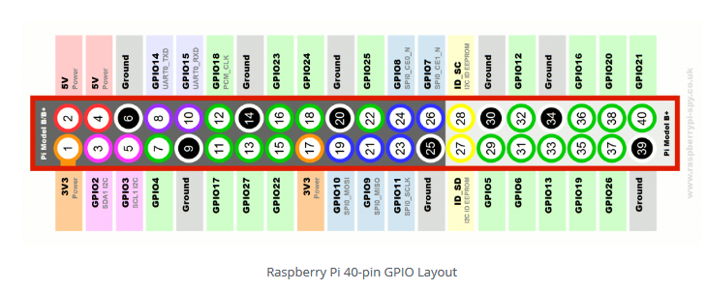
Pin layout diagram
Key hardware controls of game:
GPIO 2: Left movement button
GPIO 3: Right movement button
GPIO 17: Shoot bullet button
GPIO 27: short press for pause, long press for exit
GPIO 4: LED that indicates the game has started
GND: # Pin 6
5V: # Pin 2

Slide 12
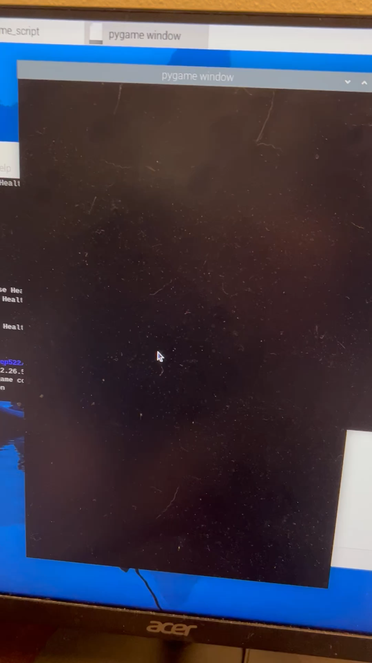
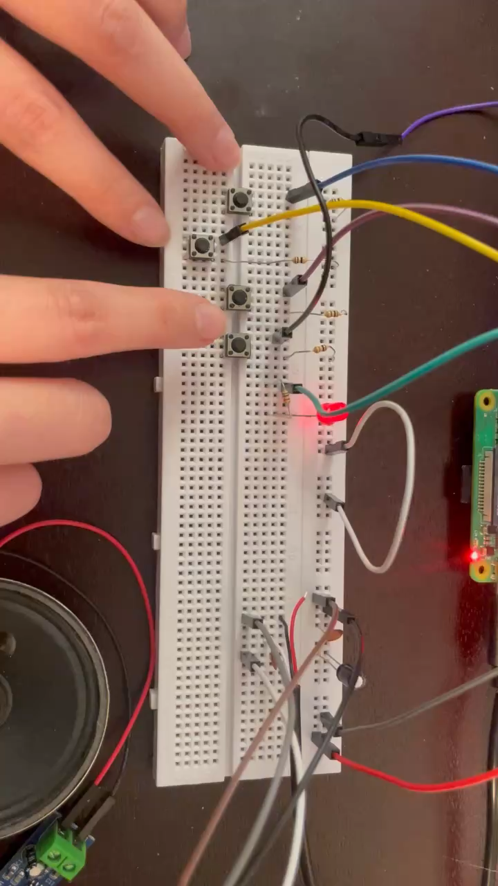

Demo
Buttons: Left, Bullet, Right, Pause/Resume/Exit
LED: Game start/end.
Speaker (bottom right corner)

Slide 13
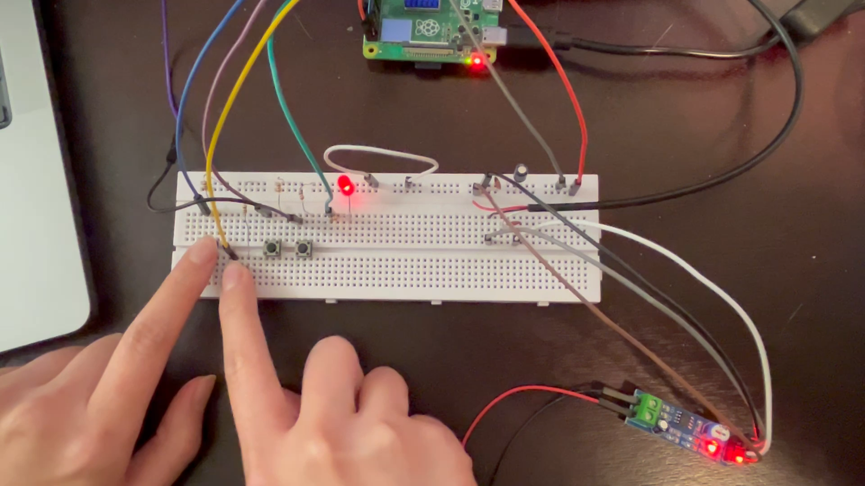
Challenges
Hardware:
- Speaker noise [on going]: improved by adding capacitors.
Presentation: Screen recording.

Slide 14
Future Improvement
- Sound quality: shorter wires, soldering, lm386 amp.
- Portable game device:
Display screen, 3D printing game case.

Slide 15
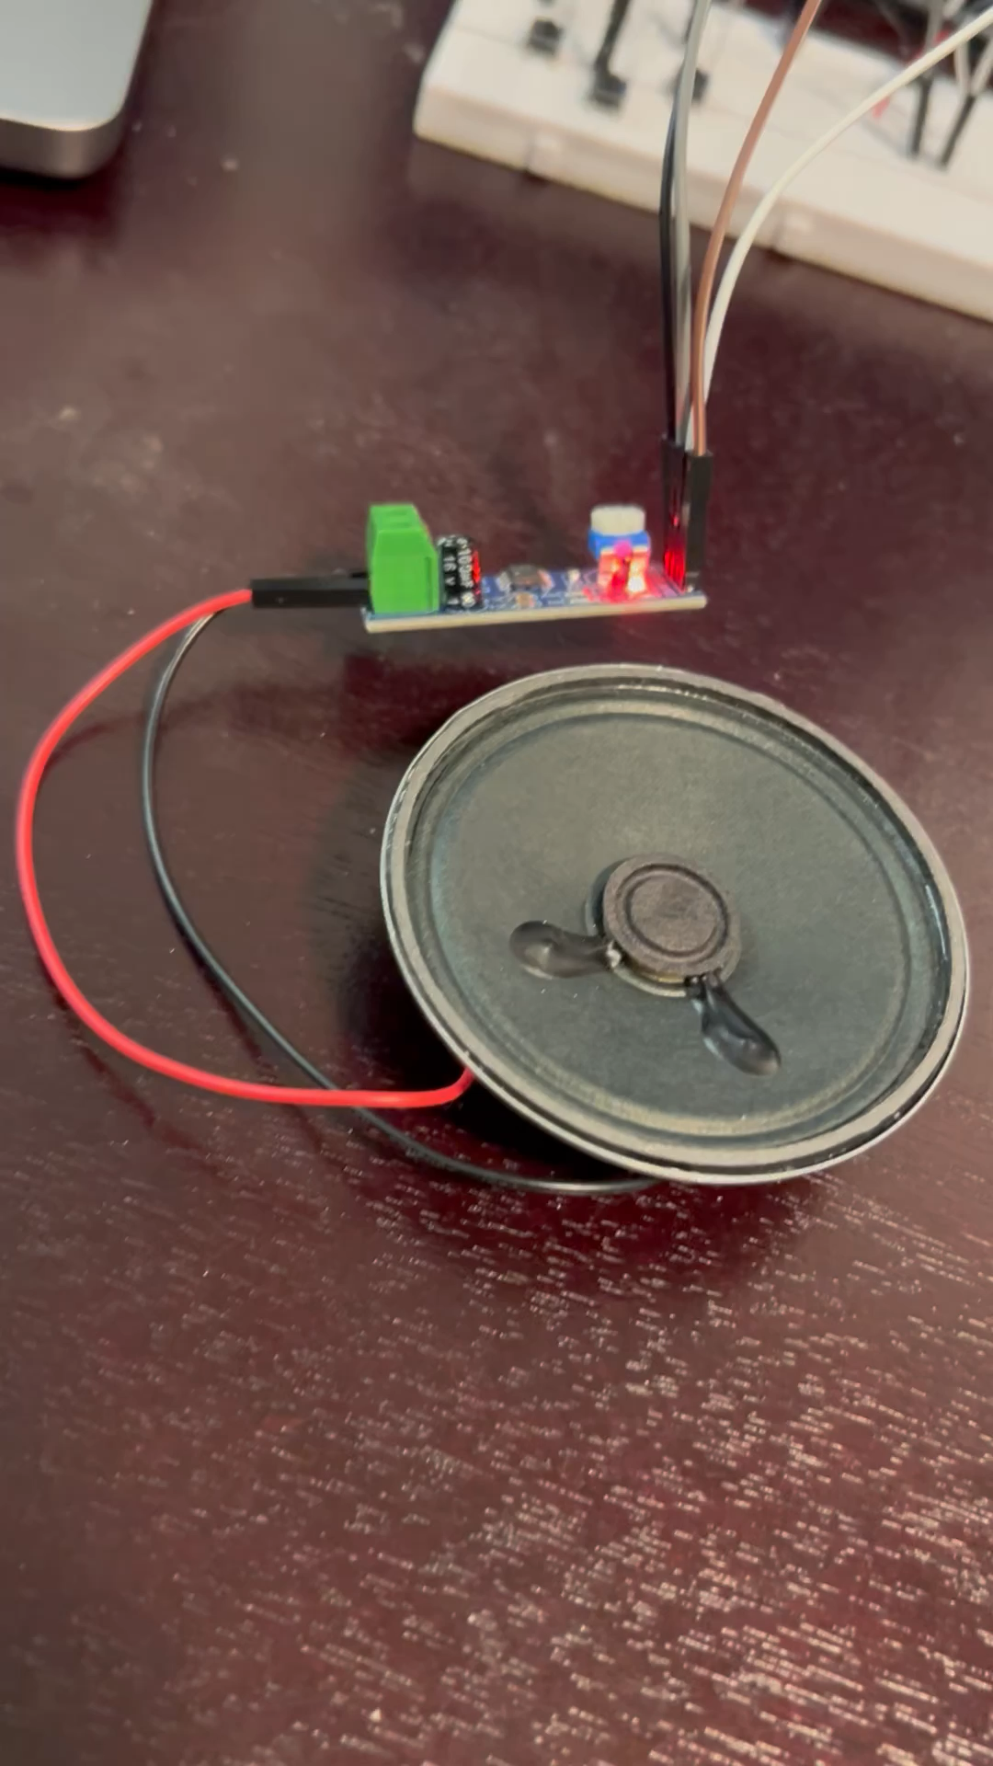
Interesting Discoveries
Speaker get input from my neightbor’s TV.
LM386 amplifier
No audio jack plug in
Bluetooth on.

Slide 16
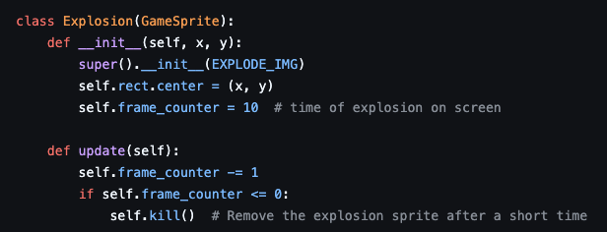
Software Design – Plane_sprite.py:
- Background Class:
- Seamless looping implementation
- Health Class:
- Visual representation of player's health
- Size and positioning properties
- Dynamic creation/removal based on player health
- Explosion Class:
- Created at collision positions
- Timed display (10 frames)
- Visual feedback for destroyed enemies

Slide 17
Reliability
- Performance: Play games continuously for several hours to check for thermal issues or degradation.
- Button tests: Rapidly press each button 100+ times to check for false triggers or missed inputs.

Slide 18
Audio Signal Path
The audio signals are generated by the Raspberry Pi's software (pygame mixer) Digital audio data is converted to analog by the Raspberry Pi's audio circuitry The analog signal travels to the LM386 amplifier module The amplifier boosts the signal to drive the speaker Filtering components remove noise and unwanted frequencies The amplified signal drives the speaker to produce sound

Slide 19
Thank you !

